Slide 1

Final Presentation
- 2D Manipulator -
DooHyun Lee
School of Mechanical Engineering
Yonsei University

Slide 2
Contents
Mid progress review
Agent algorithm problem(PPO2)
Compare models
Result

Slide 3
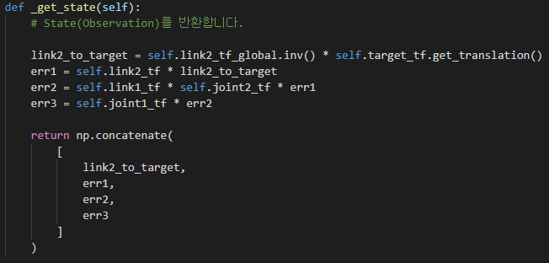
Midprogress review
State
Using position error as state
Action
Double (joint1, joint2)
-π < joint2 < π
-2π < robot, joint1< 2π

Slide 4
Midprogress review
Reward
Tol > Distance → + 1000
Out of boundary → -3000
Time over(1000 timesteps) → - 3000
- l² reward for every timestep → for minimum expected time control

Slide 5
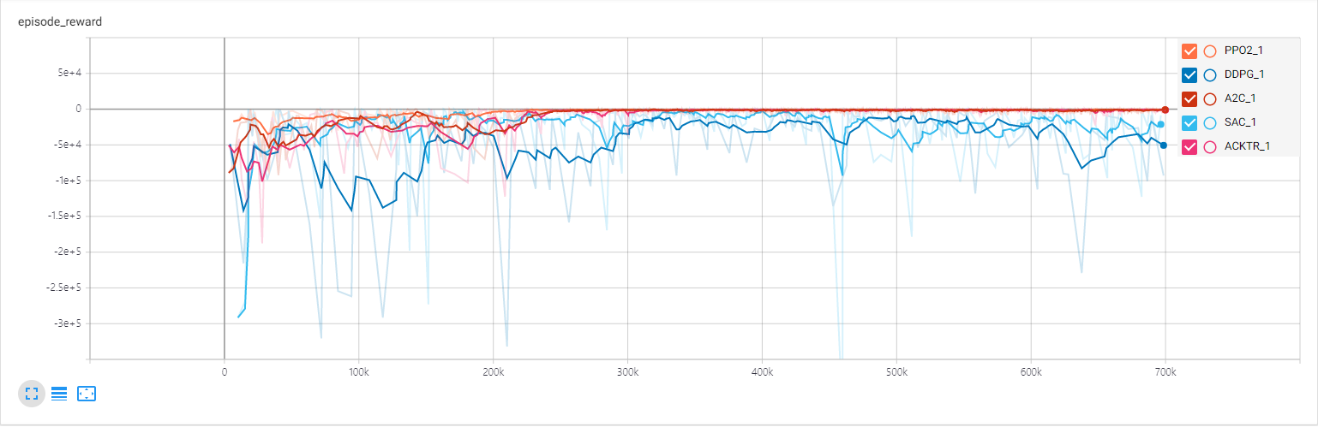
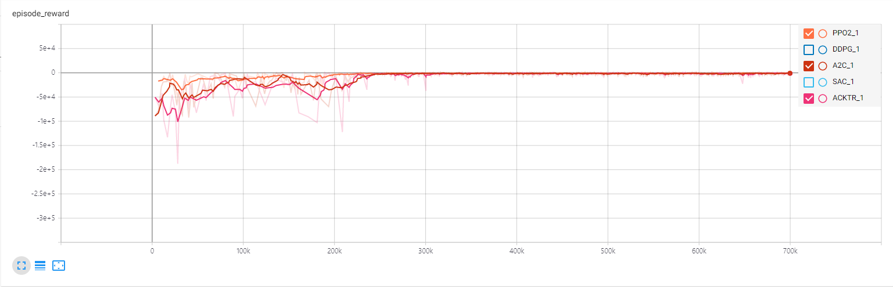
Midprogress review
Algorithm compare graph
Convergence time : PPO2 > A2C > ACKTR > SAC > DDPG
→ PPO2 shows best numerical values for the most part including convergence time

Slide 6
Midprogress review
Learning rate (gamma = 0.9)
→ Learning rate = 2.5e-4 model shows overall good figures
 | lr = 0.001 | lr = 2.5e-4 | lr = 1e-4
Episode len_mean | 601 | 230 | 275
Success counts | 332 | 2049 | 1535
Out of boundary | 39 | 69 | 107
Time for training | 12m 11s | 11m 52s | 12m 14s

Slide 7
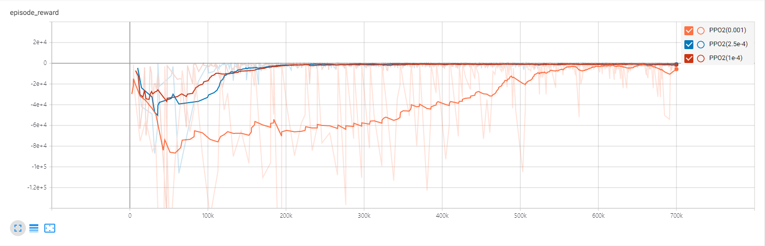
Midprogress review
Learning rate (gamma = 0.9)
There is little difference in convergence time between lr = 2.5e-4 and lr = 1e-4
Choose lr = 2.5e-4

Slide 8
Midprogress review
Gamma(lr = 2.5e-4)
 | Gamma = 0.99 | Gamma = 0.9 | Gamma = 0.5
Episode len_mean | 1300 | 230 | 260
Success counts | 224 | 2049 | 1713
Out of boundary | 88 | 69 | 241
Time for training | 12m 7s | 11m 52s | 12m 19s

Slide 9
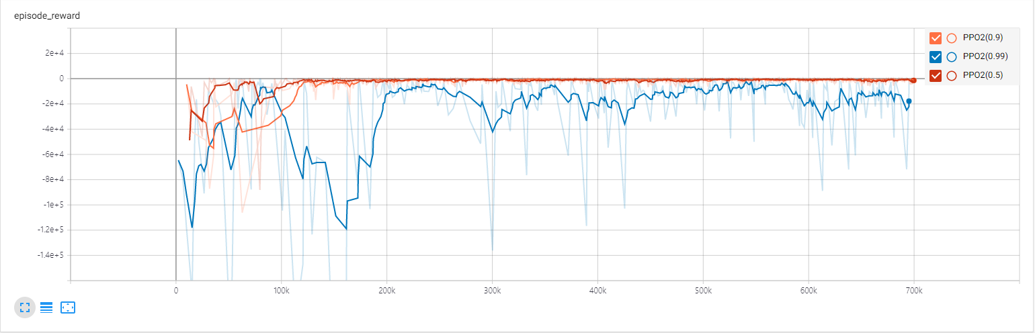
Midprogress review
Gamma(lr = 0.0001)
Gamma = 0.5 and gamma = 0.9 show similar convergence time but model with gamma of 0.5 often shows out of boundary case.
→ Choose gamma = 0.9

Slide 10
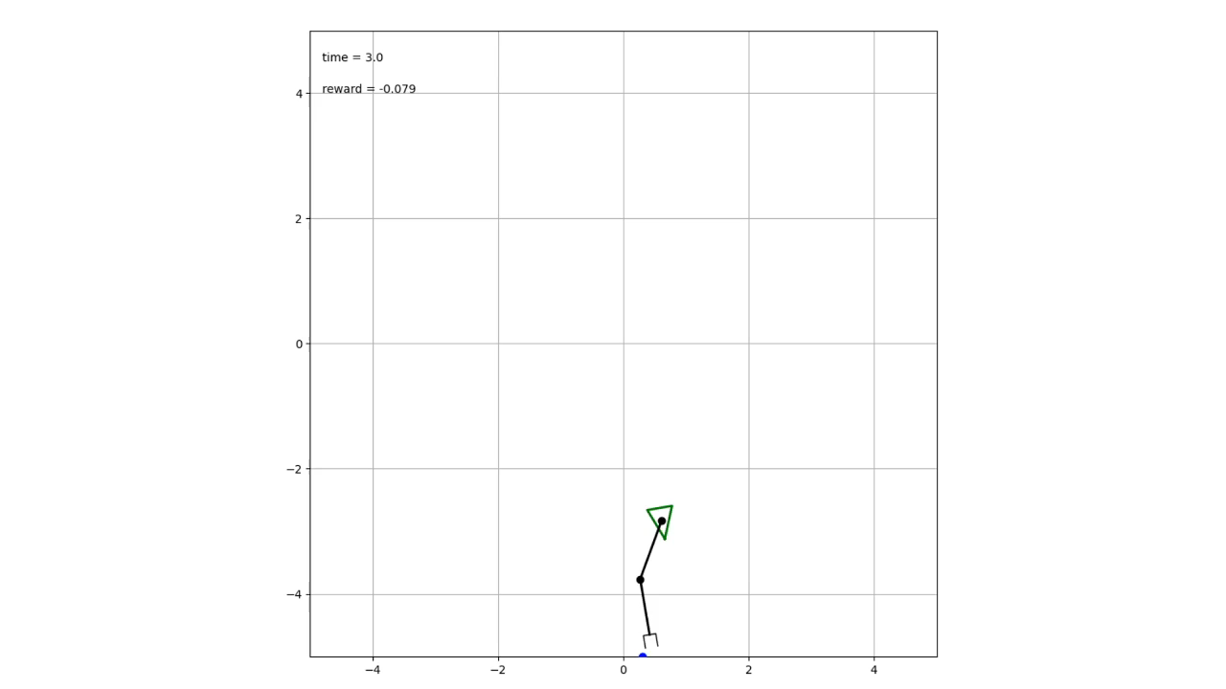
Midprogress review
PPO2
Learning rate = 2.5e-4
Gamma = 0.9

Slide 11
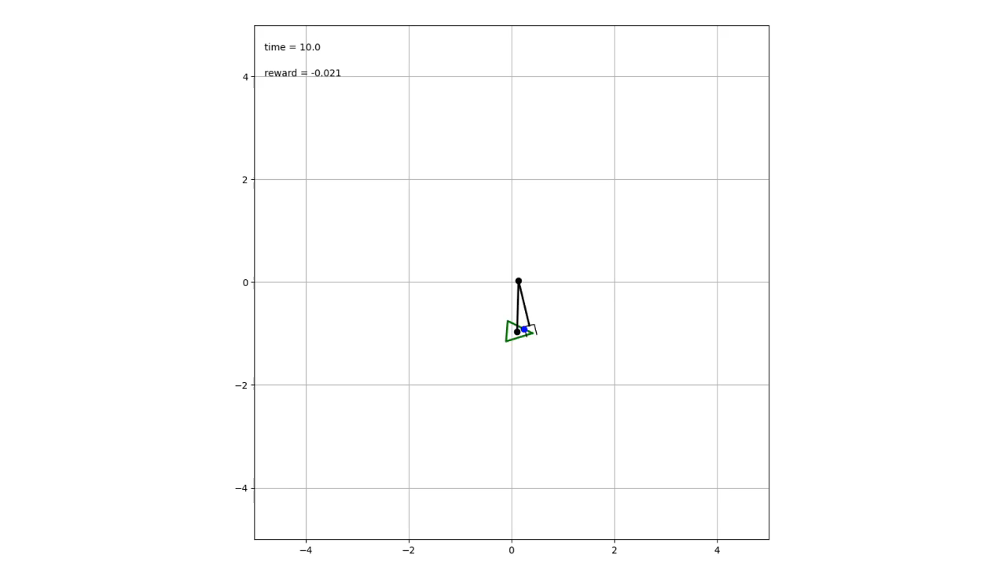
Agent algorithm problem(PPO2)
Trained Agent’s problem
Although the agent trained by PPO2 algorithm arrives at the target the fastest, end-effector vibrates a lot.
→ Can’t catch the target very well (often misses the target)

Slide 12
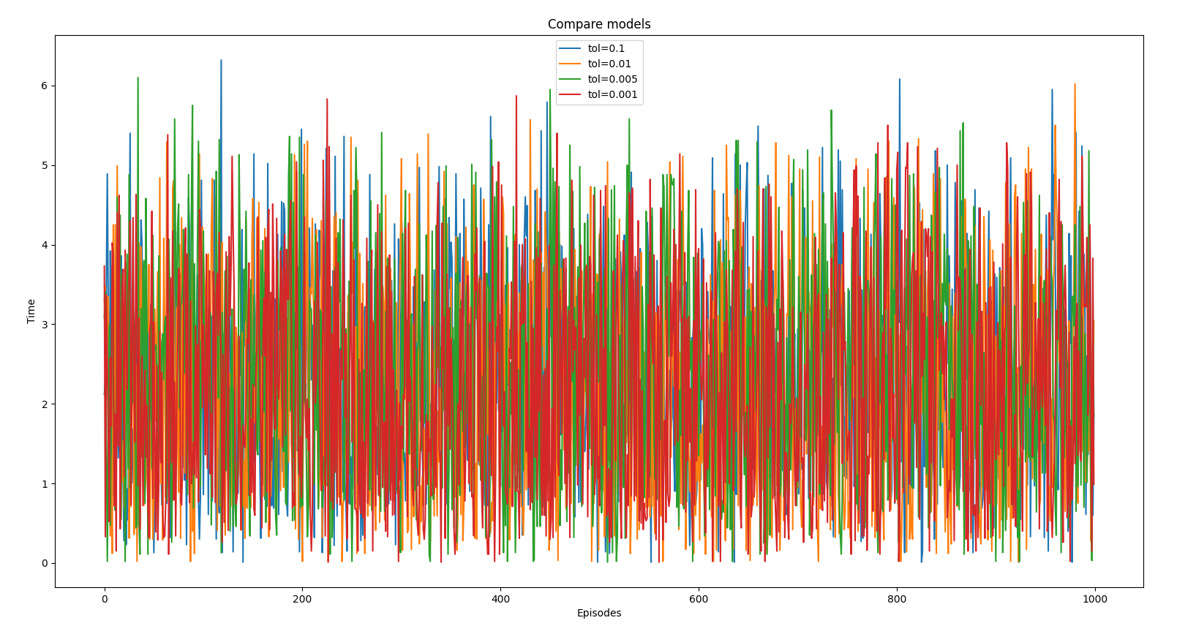
Compare models
To solve the problem, I changed the tolerance of training environment and trained the model.
Graph of the time it takes to catch a target

Slide 13
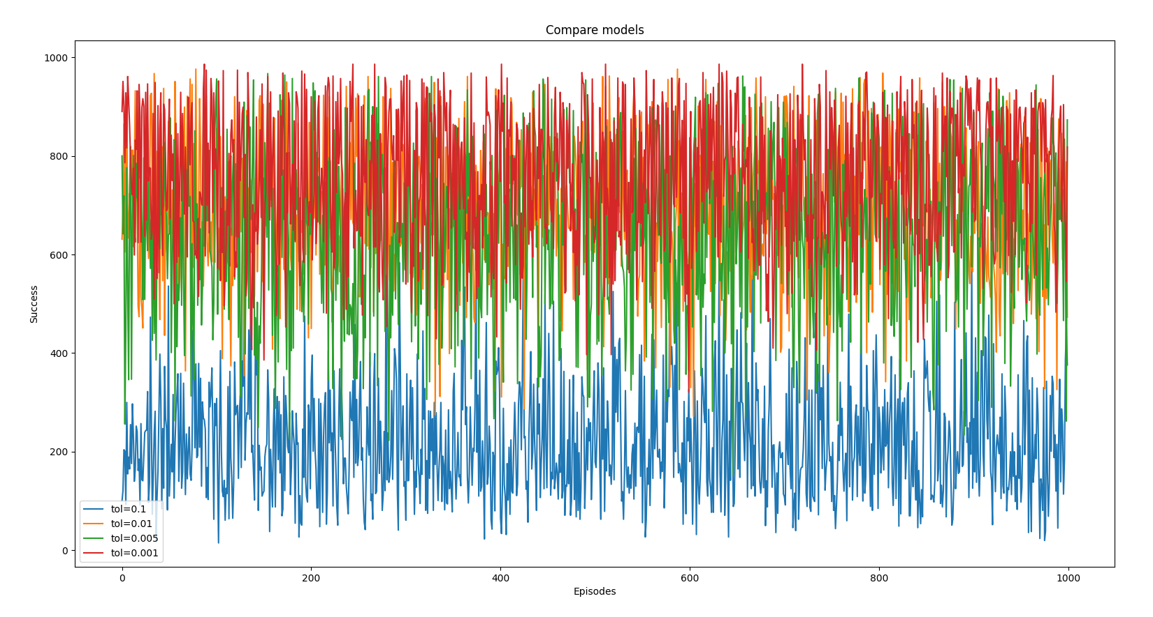
Compare models
The number of success during 1000 timesteps graph (not reset)

Slide 14
Compare models
Average results table
 | Tol = 0.1 | Tol = 0.01 | Tol = 0.005 | Tol = 0.001
Time | 2.319 | 2.236 | 2.302 | 2.221
The number of successes during 1000 timesteps | 219.104 | 693.202 | 664.078 | 756.559

Slide 15
Result
Final model
State : position error
Action
0 ≤ robot’s linear velocity ≤ 1
-2π ≤ robot, joint1 angular velocity ≤ 2π , -π ≤ joint2’s angular velocity ≤ π
Reward
Tol > Distance → + 1000
Out of boundary → -3000
Time over(1000 timesteps) → - 3000
- l² reward for every timestep → for minimum expected time control
Training timesteps : 20,000,000
Learning rate = 2.5e-4, gamma = 0.9

Slide 16
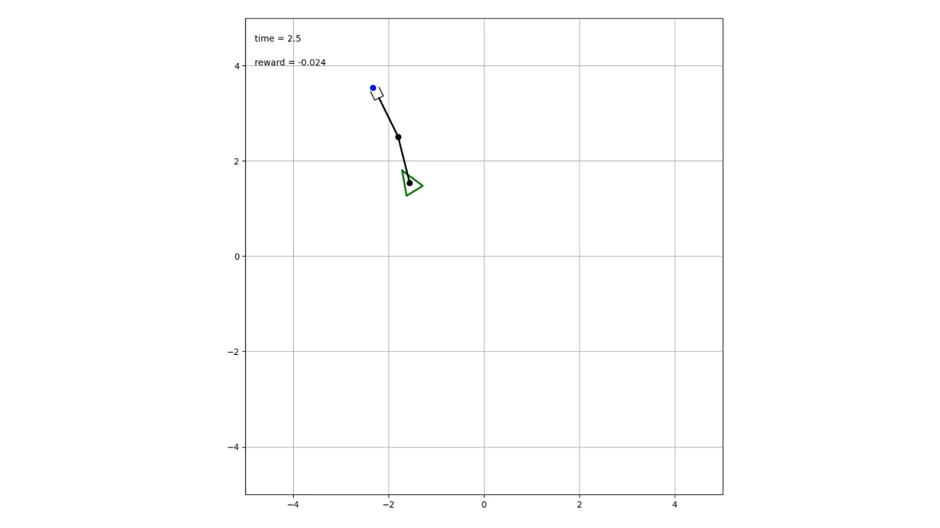
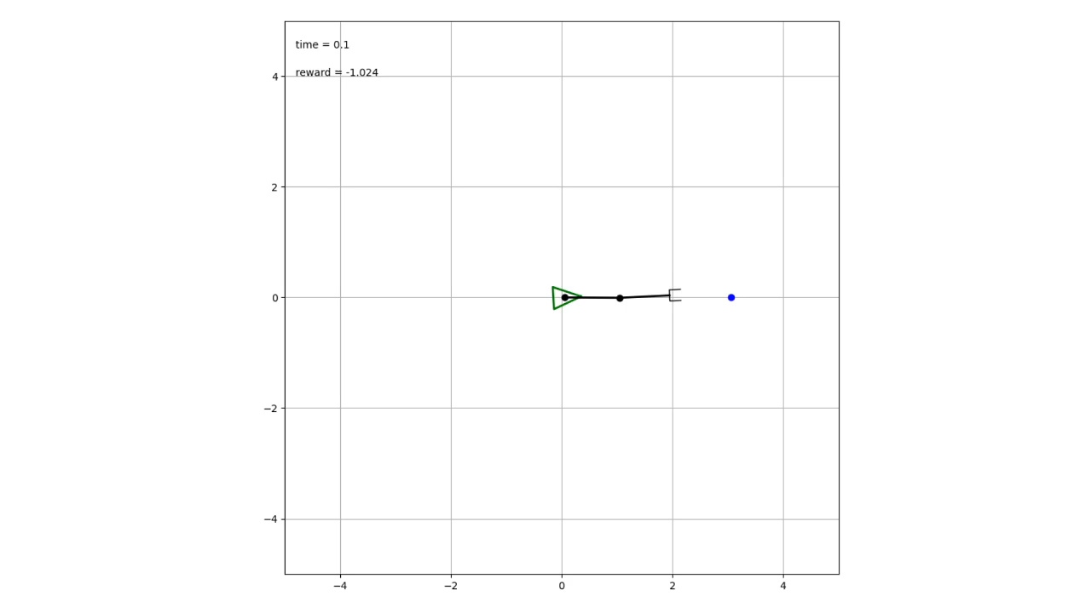
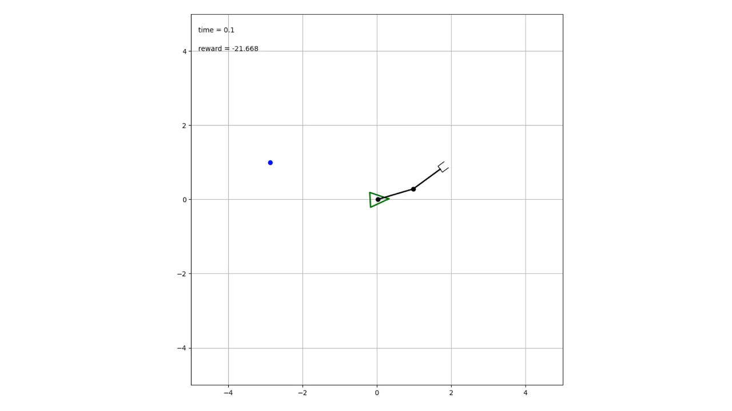
Result
During training → tol = 0.001
Test → tol = 0.1
There is still vibration, but the end-effector has become better able to catch a target
Ex. 1 Ex. 2 Ex. 3

Slide 17
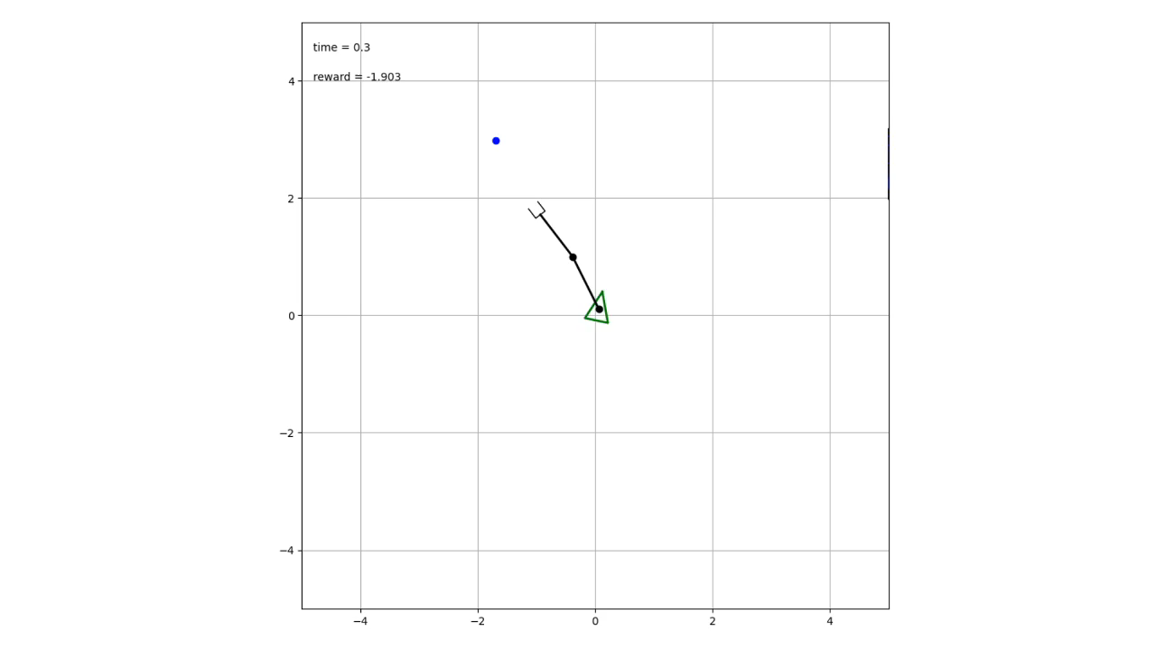
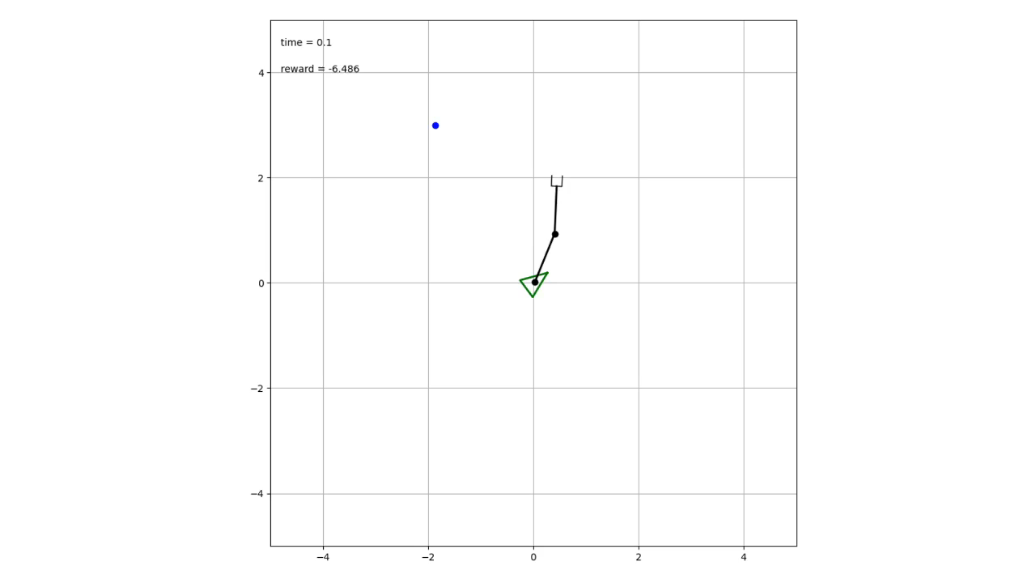
Result
Examples of the robot following a target for 1000 timesteps
Unlike before, once end-effector catch the target, it hardly misses the target
Ex. 1 Ex. 2

Slide 18
THANK YOU FOR LISTENING

